Slide 1
University of Basrah Al-zahraa medical college
Ministry of higher Education and Scientific Researches
The module: URINARY SYSTEM MODULE
Session 10 Lecture 1
MODULE STAFF:
Prof.Mahmood Shakir Dr.Adnan Othafa Ass.Prof.Firas Shakir Dr. Safaa Almatook Dr.Khaldoon Sadek
GLOMERULAR PARHOLOGY
For more detailed instruction, any question, cases need help please post to the group of session.
Clinically Orientated Anatomy Moore KL ,DalleyAF&Agur AMR
Publisher:Lippincott Williams and Wilkins:Seventh Edition: ISBN:9781451184471

Slide 2
1-describe the basic structural patterns of glomerular injury and their mechanism. 2-the basic factors responsible for the different expression of immune complex mediated disease
University of Basrah Al-zahraa medical college
Ministry of higher Education and Scientific Researches
Learning out come
For more detailed instruction, any question, cases need help please post to the group of session.

Slide 3
The blood is seperated from the glomerular filtrate by 1-fenestrated endothelium 2-basment membrane 3-podocytes and foot process all supported by mesangial cells
University of Basrah Al-zahraa medical college
Ministry of higher Education and Scientific Researches
LO1
For more detailed instruction, any question, cases need help please post to the group of session.

Slide 4
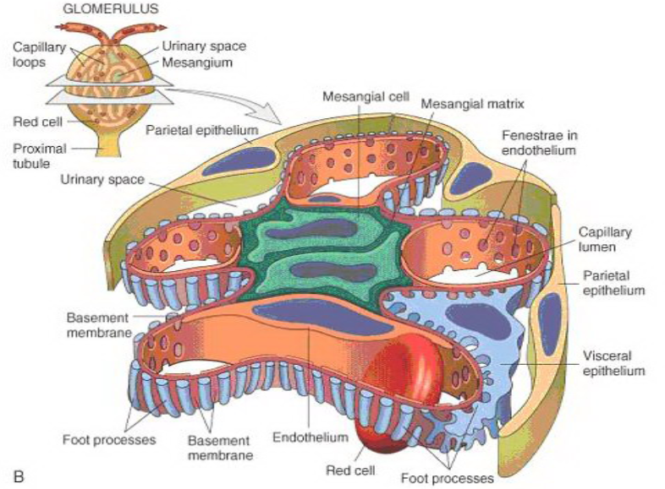
University of Basrah Al-zahraa medical college
Ministry of higher Education and Scientific Researches
LO1
For more detailed instruction, any question, cases need help please post to the group of session.

Slide 5
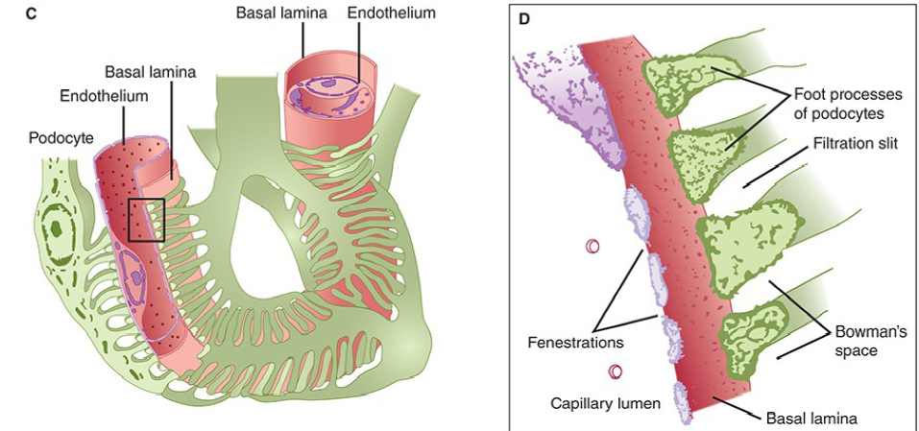
University of Basrah Al-zahraa medical college
Ministry of higher Education and Scientific Researches
LO1
For more detailed instruction, any question, cases need help please post to the group of session.

Slide 6
Damage of the glomeruli can be due to: a-immunological i.e. immune complex b-chemical toxic damage ,drugs,toxins as arsult the damage can lead to: 1-block function (clog) as in renal failure 2-leak losing protein or RBC as in nephrotic syndrome
University of Basrah Al-zahraa medical college
Ministry of higher Education and Scientific Researches
LO1
For more detailed instruction, any question, cases need help please post to the group of session.

Slide 7
The kidney is similar to other organs in that it has only a limited number of ways to respond to injury. It is, therefore, useful to begin by reviewing the basic definitions that describe the histologic findings that may be seen: ■ Focal—Involving <50% of the glomeruli on light microscopy. This limitation to light microscopy is important because most glomerular diseases involve almost all of the glomeruli if the latter are examined by electron or immunofluorescence microscopy. ■ Diffuse—Involving more than 50% of the glomeruli on light microscopy. ■ Segmental—Involving part of the glomerular tuft, usually in a focal manner. ■ Global—Involving the entire glomerular tuft; can be seen with either focal or diffuse disease. ■ Membranous—Thickening of the glomerular capillary wall (GCW), usually with distinctive basement membrane “spikes.” ■ Proliferative—An increased number of cells in the glomerulus; these cells can be either proliferating glomerular cells or infiltrating circulating inflammatory cells. The term exudative is also used when there is prominent infiltration by neutrophils.
University of Basrah Al-zahraa medical college
Ministry of higher Education and Scientific Researches
LO1
For more detailed instruction, any question, cases need help please post to the group of session.

Slide 8
University of Basrah Al-zahraa medical college
LO1
■ Proliferative—An increased number of cells in the glomerulus; these
cells can be either proliferating glomerular cells or infiltrating circulating
inflammatory cells. The term exudative is also used when there is prominent
infiltration by neutrophils.
■ Membranoproliferative—The presence of thickening of the GCW with
distinctive double contours or “tram tracks” and proliferative changes in
the glomeruli.
■ Crescent—An accumulation of cells (mostly mononuclear cells derived
from the circulation and proliferated parietal epithelial cells) within
Bowman’s space; crescents often compress the capillary tuft and are associated
with a more severe and rapidly progressive disease.
■ Glomerulosclerosis—Segmental or global capillary collapse or obsolescence
with closure of the capillary lumens; it is presumed that there is little
if any filtration across sclerotic areas.
■ Glomerulonephritis—Any condition associated with inflammation in
the glomerular tuft.
For more detailed instruction, any question, cases need help please post to the group of session.

Slide 9
Pathology of glomerular damage it is damaged by: 1-direct depostion of antigen-antibody complex 2-antibody react to either intrinsic antigene or extrinsic antigene that deposit in the wall the damage can affect ; subendothelial layer basment membrane mesangial subepithelial
University of Basrah Al-zahraa medical college
Ministry of higher Education and Scientific Researches
LO2
For more detailed instruction, any question, cases need help please post to the group of session.

Slide 10
Pathological types of Glomerular damage 1-Acute diffuse proliferative 2-Rapidly progressive (crescentic) 3-Membranous glomerulopathy (idiopathic 4-Minimal change disease. 5-Focal segmental glomerulosclerosis. 6-Membranoproliferative GN (mesangiocapillary 7-IgA nephropathy (Focal 8-Chronic
University of Basrah Al-zahraa medical college
Ministry of higher Education and Scientific Researches
LO2
For more detailed instruction, any question, cases need help please post to the group of session.

Slide 11
University of Basrah Al-zahraa medical college
Ministry of higher Education and Scientific Researches
LO2
nephrotic
nephritic
Proteinurea
Hypoalbuminemia
Oedema
hyperlipedimia
Haematurea
Hypertension
Azotemia
oligurea
For more detailed instruction, any question, cases need help please post to the group of session.

Slide 12
Acute diffuse proliferative GN post streptococcal there will be hypercellularity of neutrophil and monocytes and proliferation of endothelial and mesangial cells
University of Basrah Al-zahraa medical college
Ministry of higher Education and Scientific Researches
LO2
For more detailed instruction, any question, cases need help please post to the group of session.

Slide 13
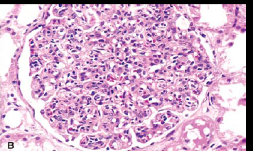
University of Basrah Al-zahraa medical college
Ministry of higher Education and Scientific Researches
LO2
For more detailed instruction, any question, cases need help please post to the group of session.

Slide 14
Rapidly progressive histologically charecterized by cresecent formation that block Bowmans capsul . By proliferation of parietal cells and monocytes and macrophages
University of Basrah Al-zahraa medical college
Ministry of higher Education and Scientific Researches
LO2
For more detailed instruction, any question, cases need help please post to the group of session.

Slide 15
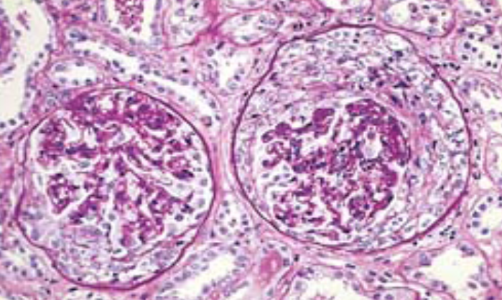
University of Basrah Al-zahraa medical college
Ministry of higher Education and Scientific Researches
LO2
For more detailed instruction, any question, cases need help please post to the group of session.

Slide 16
Membranous glomerulopathy commonest cause for Nephrotic syndrome could be autoimmune associated with SLE,ca ,drugs pathologicaly show diffuse thickening of the capillary wall
University of Basrah Al-zahraa medical college
Ministry of higher Education and Scientific Researches
LO2
For more detailed instruction, any question, cases need help please post to the group of session.

Slide 17
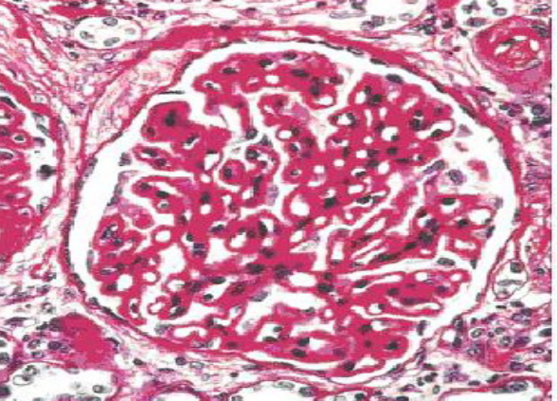
University of Basrah Al-zahraa medical college
Ministry of higher Education and Scientific Researches
LO2
For more detailed instruction, any question, cases need help please post to the group of session.

Slide 18
Minimal change usually affect children good response to steroids usually associated with proteinurea pathologically no obvious change apart of effacment of foot process
University of Basrah Al-zahraa medical college
Ministry of higher Education and Scientific Researches
LO2
For more detailed instruction, any question, cases need help please post to the group of session.

Slide 19
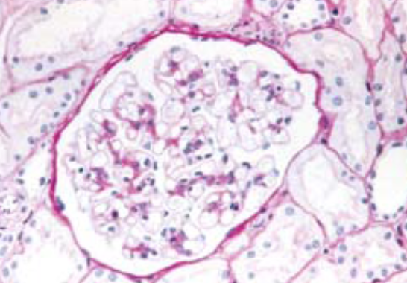
University of Basrah Al-zahraa medical college
Ministry of higher Education and Scientific Researches
LO2
For more detailed instruction, any question, cases need help please post to the group of session.

Slide 20
Focal mainly middle age hyaline thickening of capelleries uncertain response to steroid ot cytotoxic
University of Basrah Al-zahraa medical college
Ministry of higher Education and Scientific Researches
LO2
For more detailed instruction, any question, cases need help please post to the group of session.

Slide 21
Membranoproliferative mainly older children may progress in to chronic renal failure poor response to immunesuppression
University of Basrah Al-zahraa medical college
Ministry of higher Education and Scientific Researches
LO2
For more detailed instruction, any question, cases need help please post to the group of session.

Slide 22
Renal pathology outline glomerular disease can be in one of two main groups 1-Nephrotic syndrome: a)minimal change b)focal segmental glomerulosclerosis c)membranous 2-Nephritic syndrome: a)postinfectious b)IgA nephopathy
University of Basrah Al-zahraa medical college
Ministry of higher Education and Scientific Researches
LO2
For more detailed instruction, any question, cases need help please post to the group of session.

Slide 23
University of Basrah Al-zahraa medical college
Ministry of higher Education and Scientific Researches
LO2
For more detailed instruction, any question, cases need help please post to the group of session.

